Slide 1
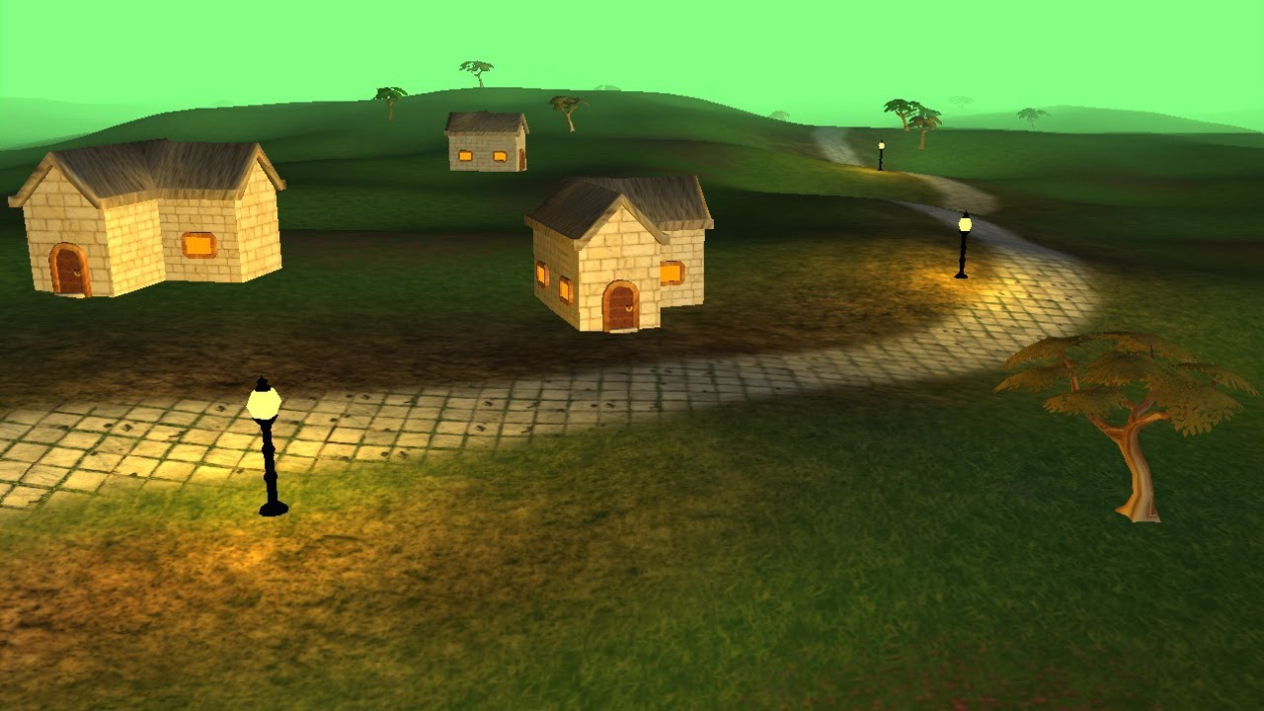
3D Game Engine
Group Members:
Teimuraz Pkhakadze
Luka Karoiani
Nika Pkhakadze
Levan Nakashidze

Slide 2

Brief Introduction to the project
Create basic rendering engine design
3D Model loading
Calculation and rendering particular scene
Use mathematical models to predict object behavior

Slide 3
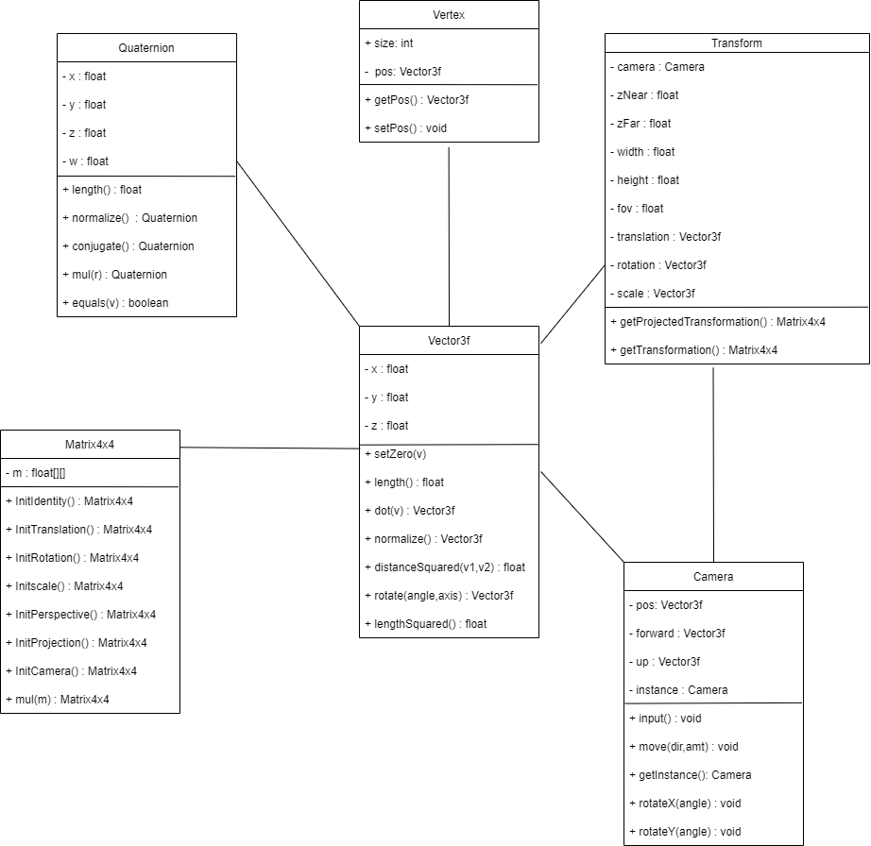




UML Diagram

Slide 4
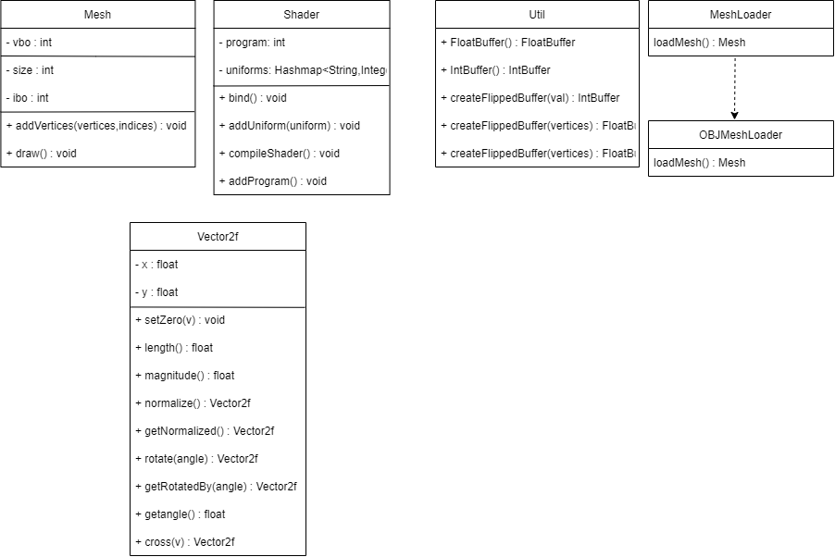
UML Diagram

Slide 5
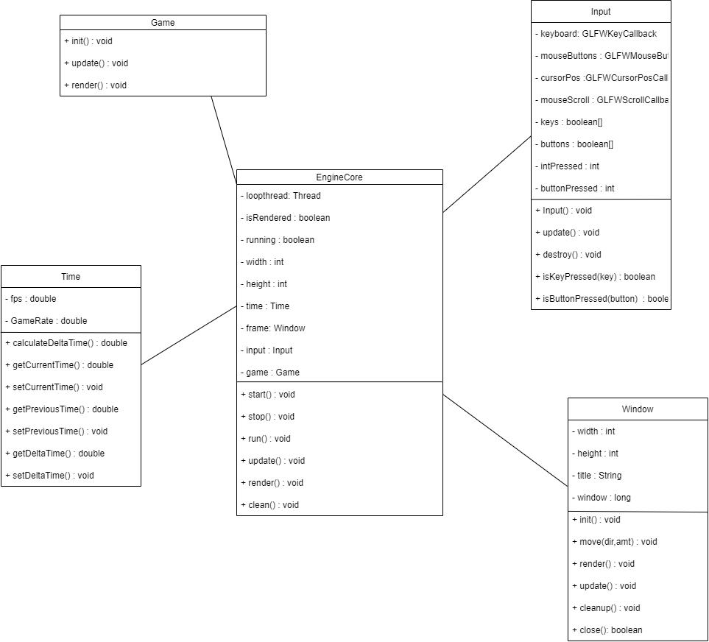
UML Diagram

Slide 6

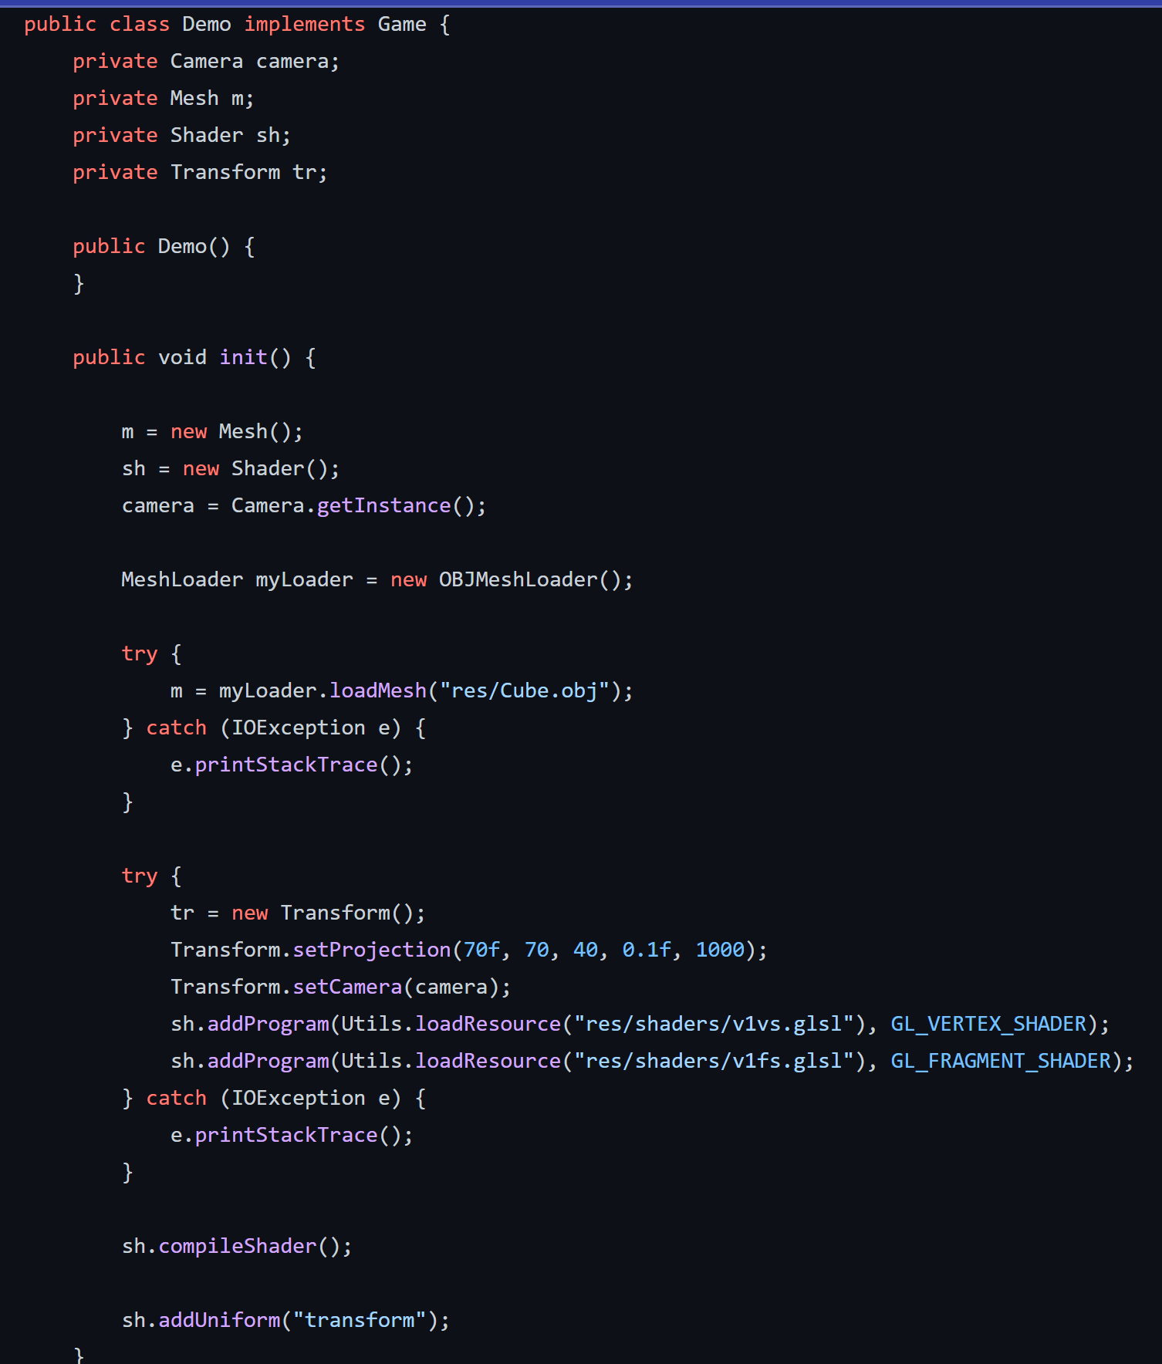
Game Class Implementation
Main steps to create game with one class:
Create class which implements Game interface
Initialize class attributes
Load objects you want to render
Customize Meshes and Shaders as wanted
Create Instance of camera

Slide 7


Demo

Slide 8
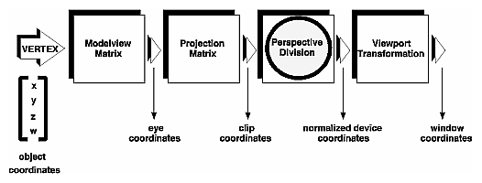
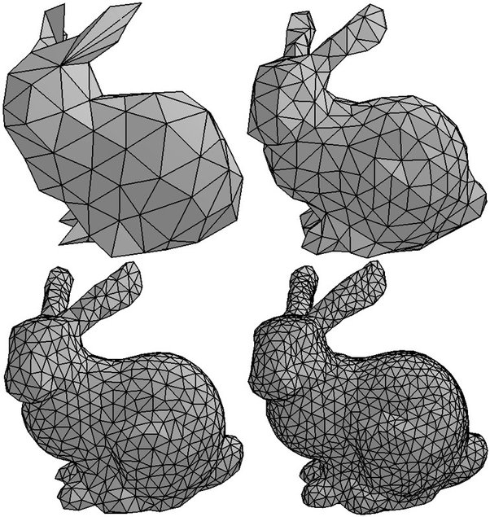
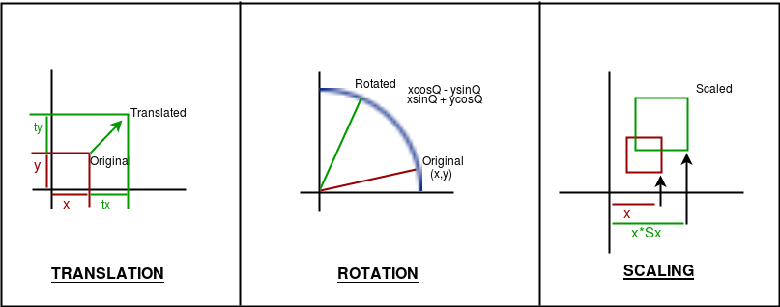
Component Descriptions
Mesh – Base class for representing 3D geometric surface
Transformation - process of manipulating the view of a three-D object with respect to its original position by modifying its physical attributes through various methods like Translation, Scaling, Rotation
Game – Interface containing methods to create the display and setup the game loop
Engine – Setting up mechanics, which decides when the game is updated, rendered and checks for input

Slide 9
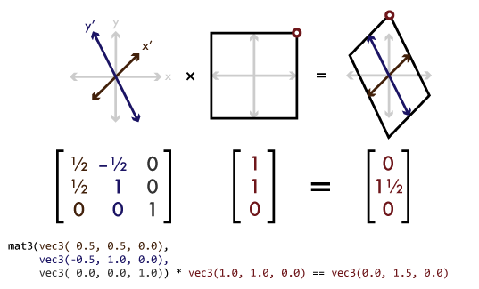
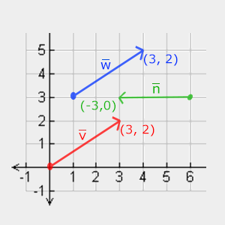
Temo
Matrix4x4
Quaternion
Vector2f
Vector3f
Transform

Slide 10
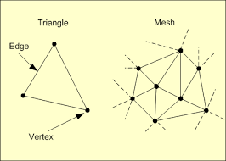
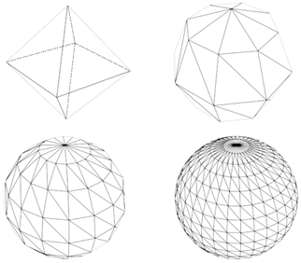
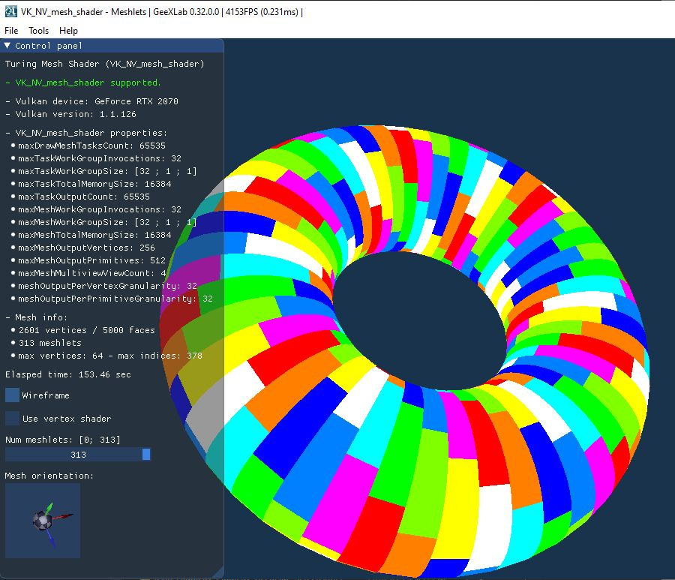
Nika
Vertex
Mesh
Shader
Util
Mesh Loader
OBJ Mesh Loader

Slide 11
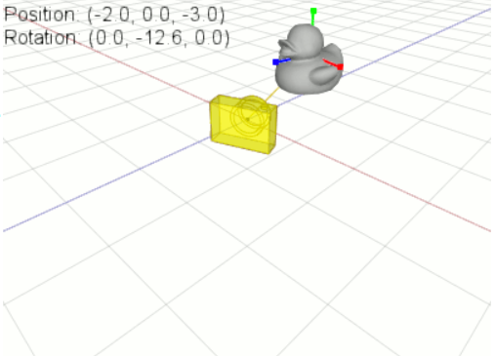
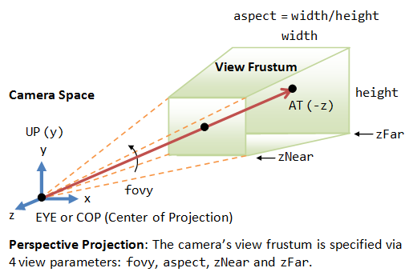
Levani
Camera
Window
Engine Core
Perspective projection
Game Interface
CI pipeline

Slide 12



Luka - Input Class
Importance of Inputs
Inputs' purpose in our project

Slide 13
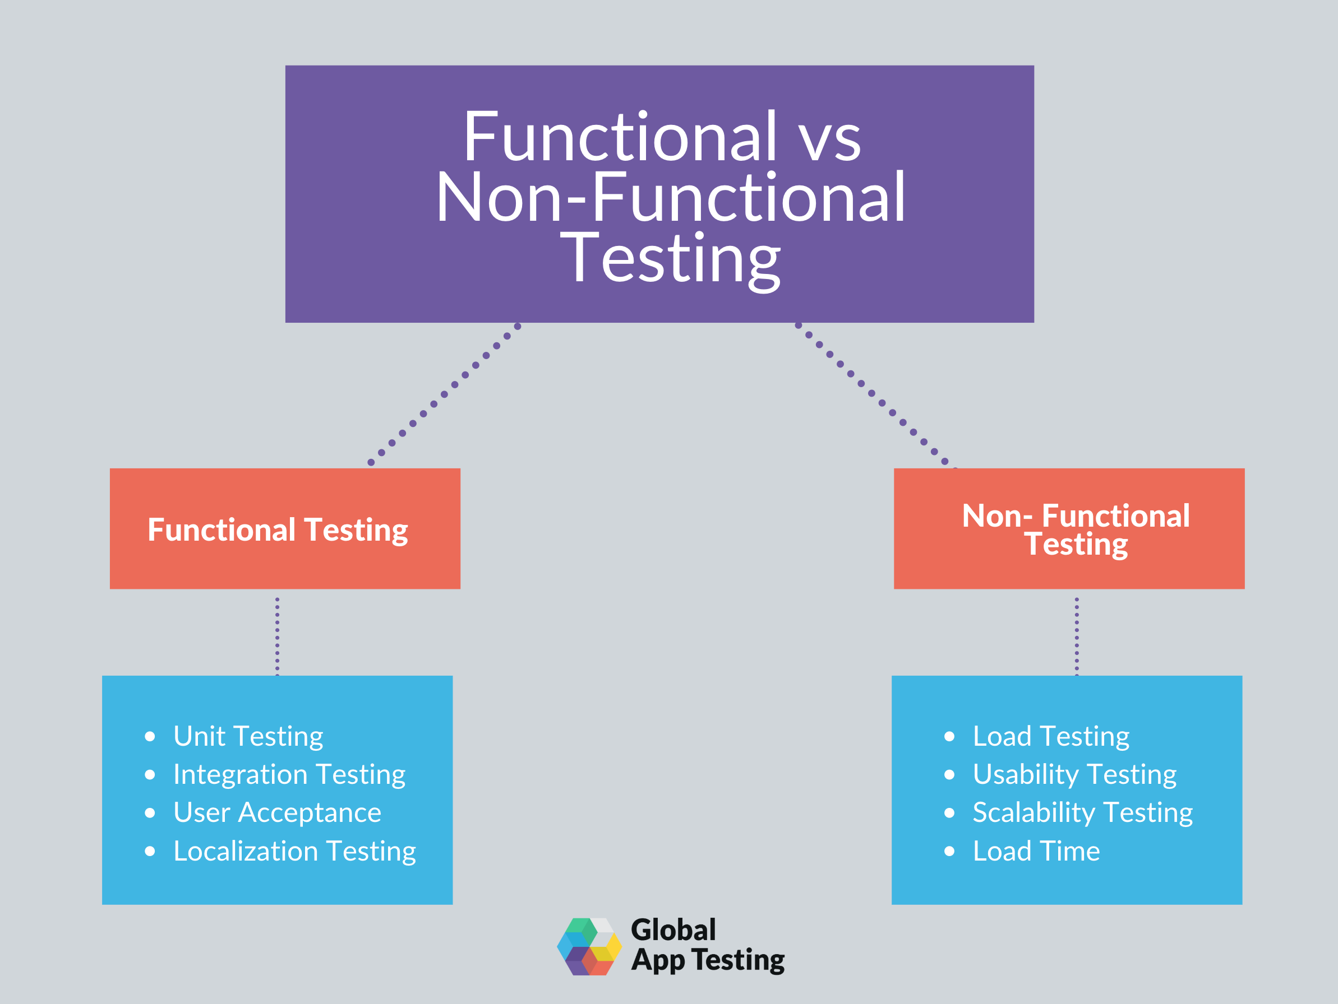
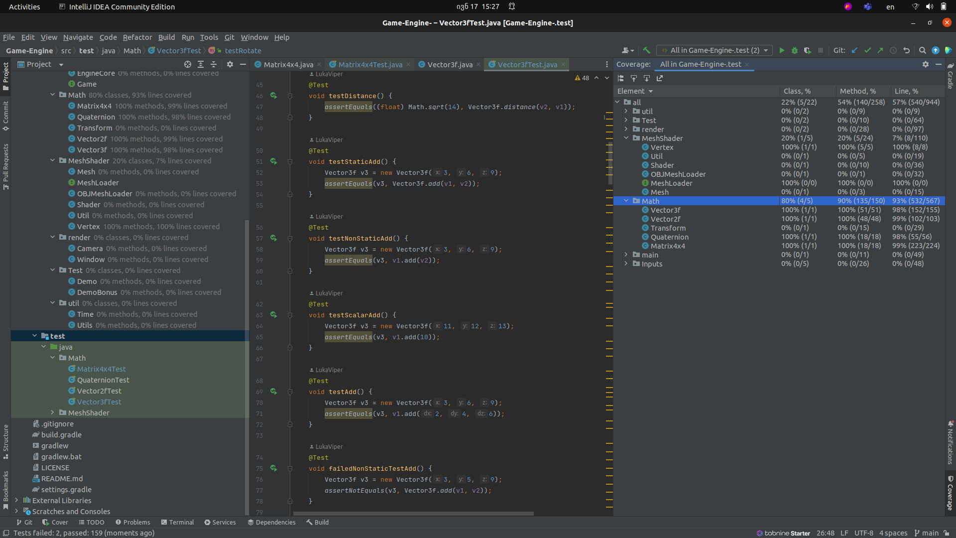
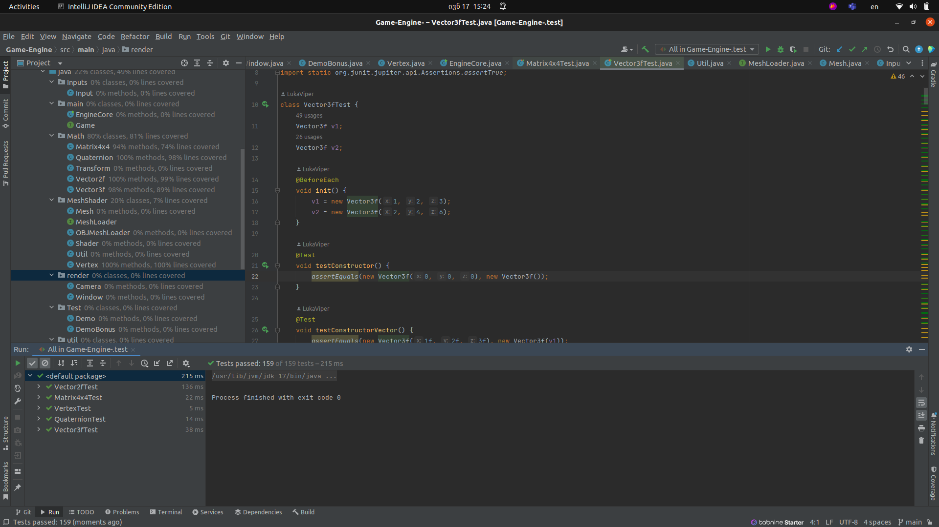
Luka – Test Classes
Testing – Before and Now
Types of testing
Importance of the unit testing
Testing in our project

Slide 14


